Slide 1

MSECC
Coordinator Training
August 26, 2026
Notes:
Click record on training

Slide 2
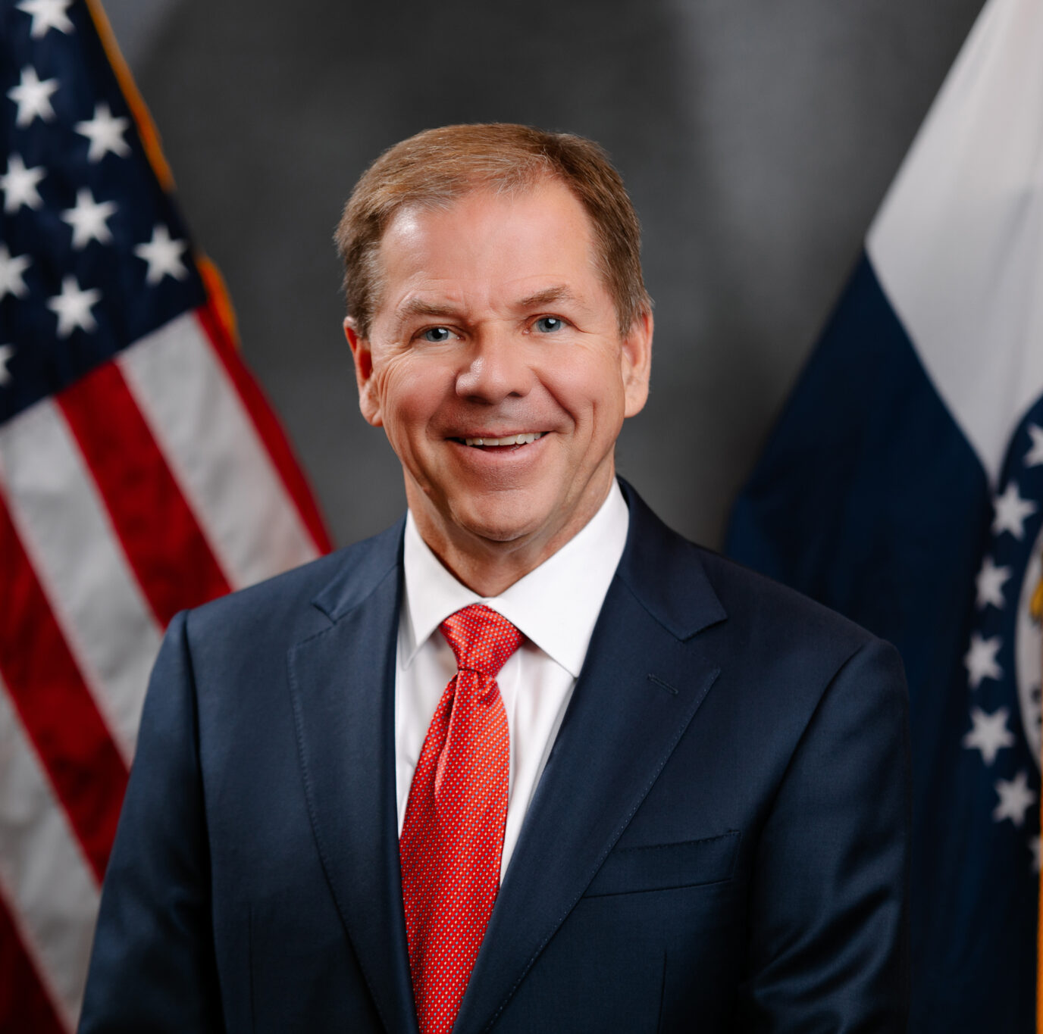

2027 Campaign
Chairman
Lieutenant Governor
David Wasinger

Slide 3

What is MSECC?
MSECC is a unified fundraising program for State Team Members administered by the Office of Administration, housed in the Office of Equal Opportunity
Comprised of charitable organizations vetted and approved for inclusion in the MSECC
Participating charities provide vital services and meet many needs in our local communities and state
Payroll deduction offers employees a convenient tax-deductible way to contribute

Slide 4

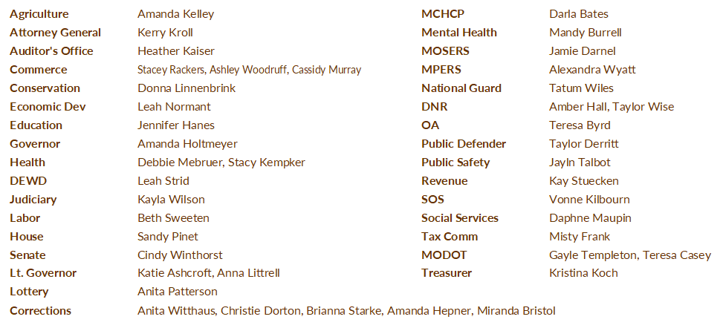

Department Coordinators

Slide 5
What is Your Role?
Provide leadership & serve as the main campaign resource for your agency
Distribute pledge cards to employees or direct them to the online system
Encourage participation – without pressure
Be positive and enthusiastic about the campaign
Encourage agency management’s involvement

Slide 6
What is Your Role?
Plan events: https://msecc.mo.gov/coordinators/
Distribute pledge cards no later than October 15
Collect completed pledge cards by October 31
If you need more time, just keep MSECC office in the loop
Send completed pledge cards to your department coordinator OR directly to the MSECC office via inter-agency mail

Slide 7
Fun Facts…
If every state team member donated $1 per pay period, more than $1.2 million dollars would be raised for charity
8.75% participated last year
4,434 team members donated last year
$782,186 raised last year

Slide 8

Campaign Website
https://msecc.mo.gov
msecc.mo.gov
HOME
Campaign Banner & Poster
Photos from Kick-Off
SPONSORS
Image Carousel - Links to all MSECC Sponsors
FAQ, TOTALS & UPDATES
Campaign totals
Monthly Newsletter
CHARITIES
Quick Reference Guide
Charity Search
COORDINATORS
Coordinator Resources
Copy of Coordinator Training
DONATE
Current Employees
Retirees

Slide 9

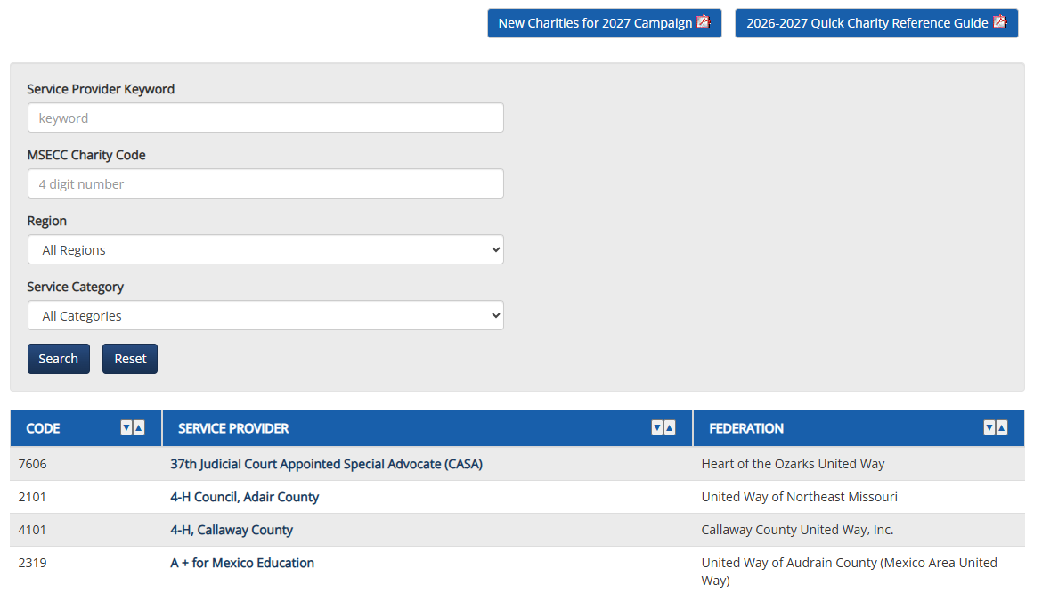
msecc.mo.gov
Quick Charity Reference Guide
The Quick Charity Reference Guide PDF is available to print on the website
Charities are listed alphabetically by regions
523 charities are enrolled in the 2027 campaign

Slide 10
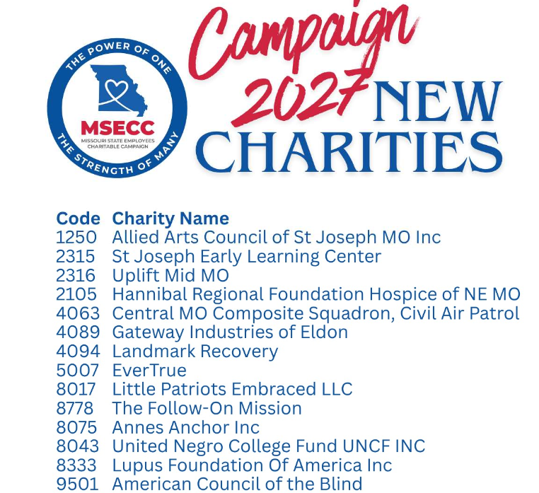

msecc.mo.gov

Slide 11



msecc.mo.gov

Slide 12
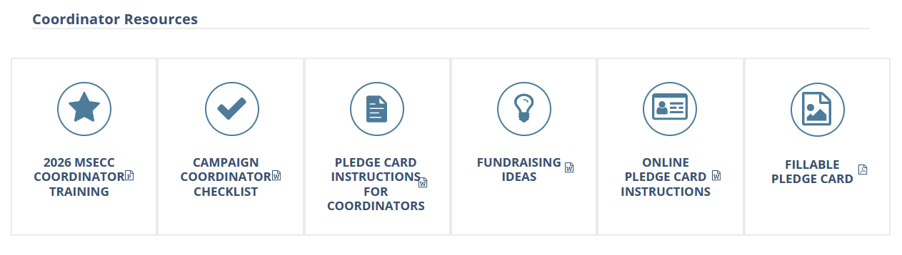
msecc.mo.gov

Slide 13

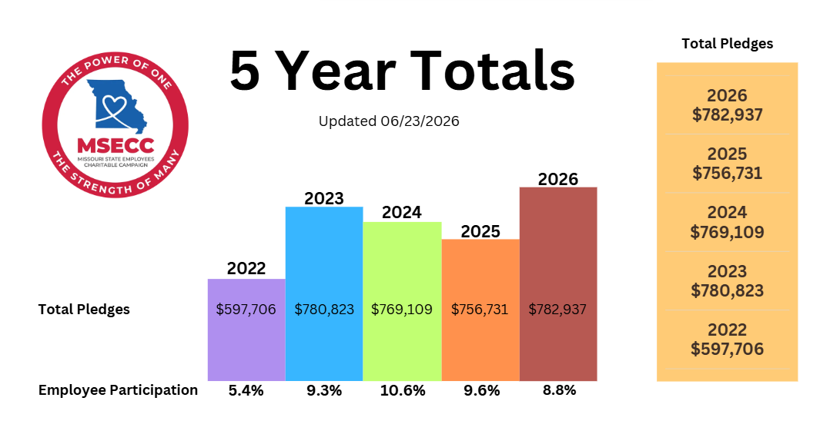
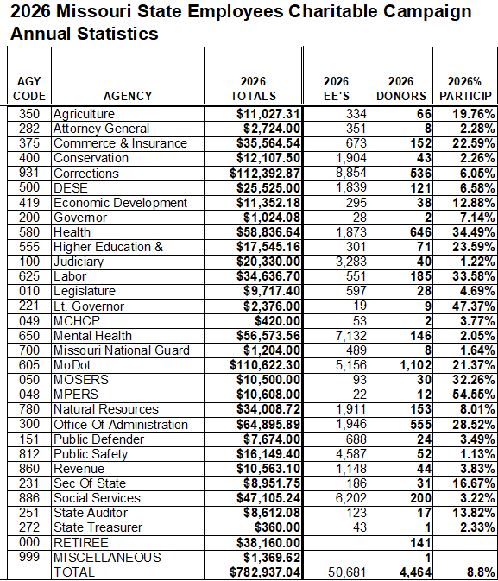

msecc.mo.gov

Slide 14
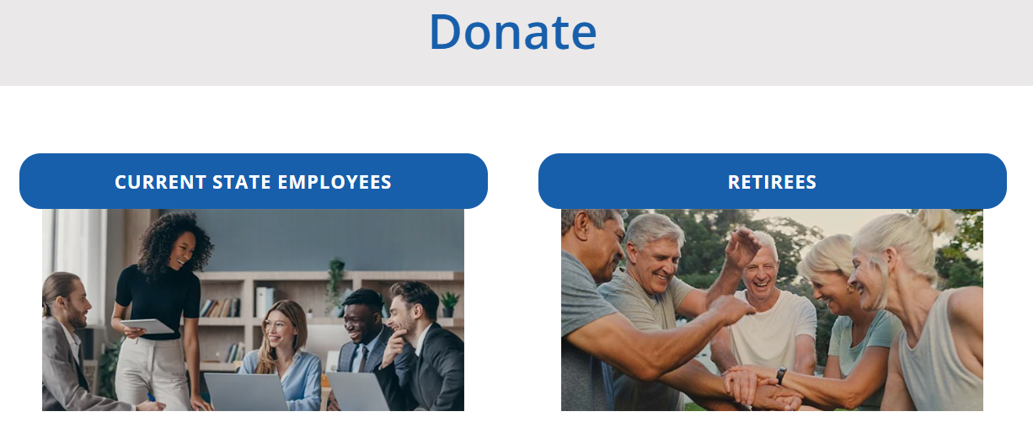
msecc.mo.gov

Slide 15
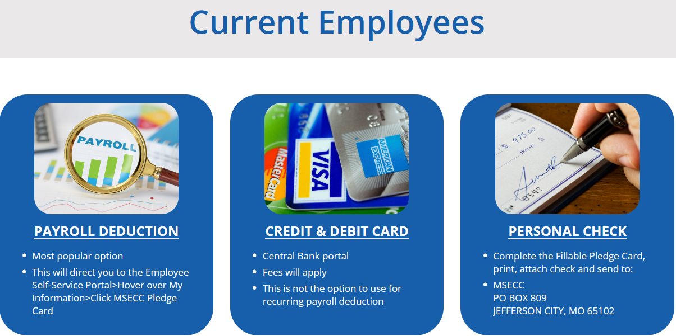
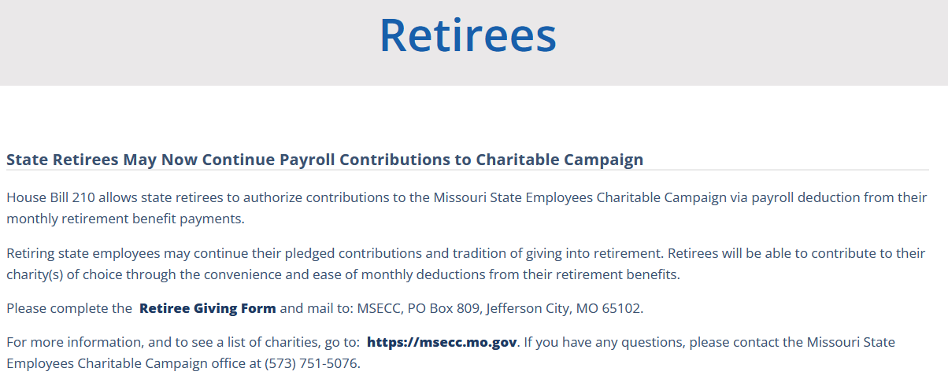
msecc.mo.gov

Slide 16
Online (ESS) Pledge Card
  ess.mo.gov
  Only for Payroll Deductions
  Most Popular Option
  Available in the Employee Self-Service Portal (ESS)

Slide 17
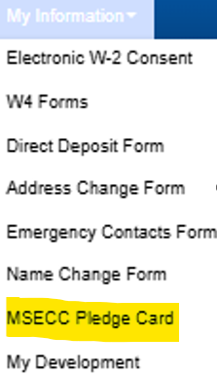
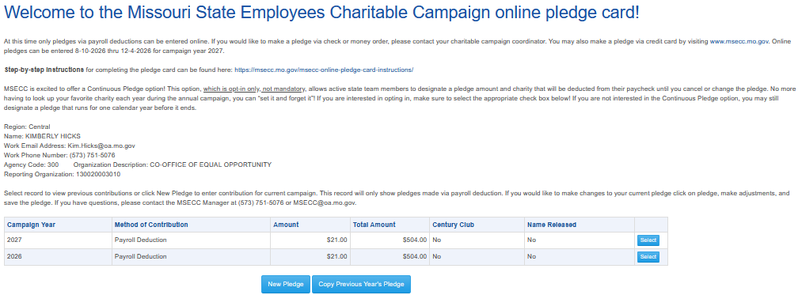
Online (ESS) Pledge Card
ess.mo.gov

Slide 18
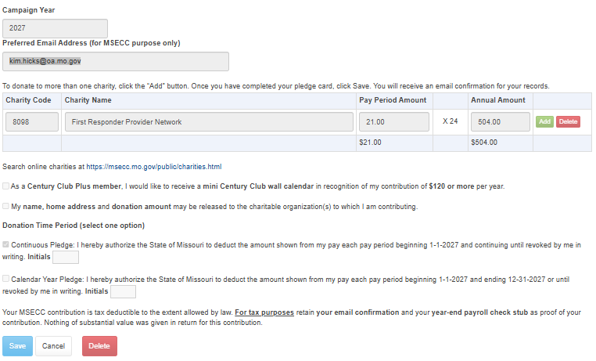
Online (ESS) Pledge Card
ess.mo.gov

Slide 19
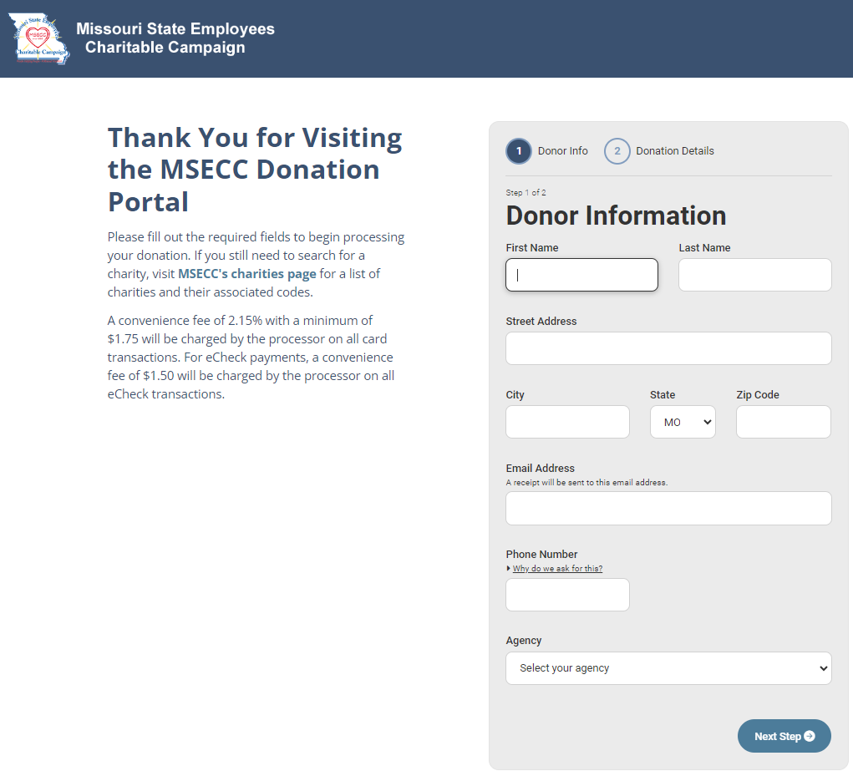
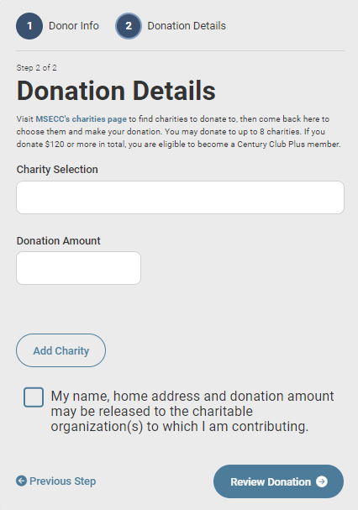
Credit Card Donations
msecc.centralbank.net

Slide 20
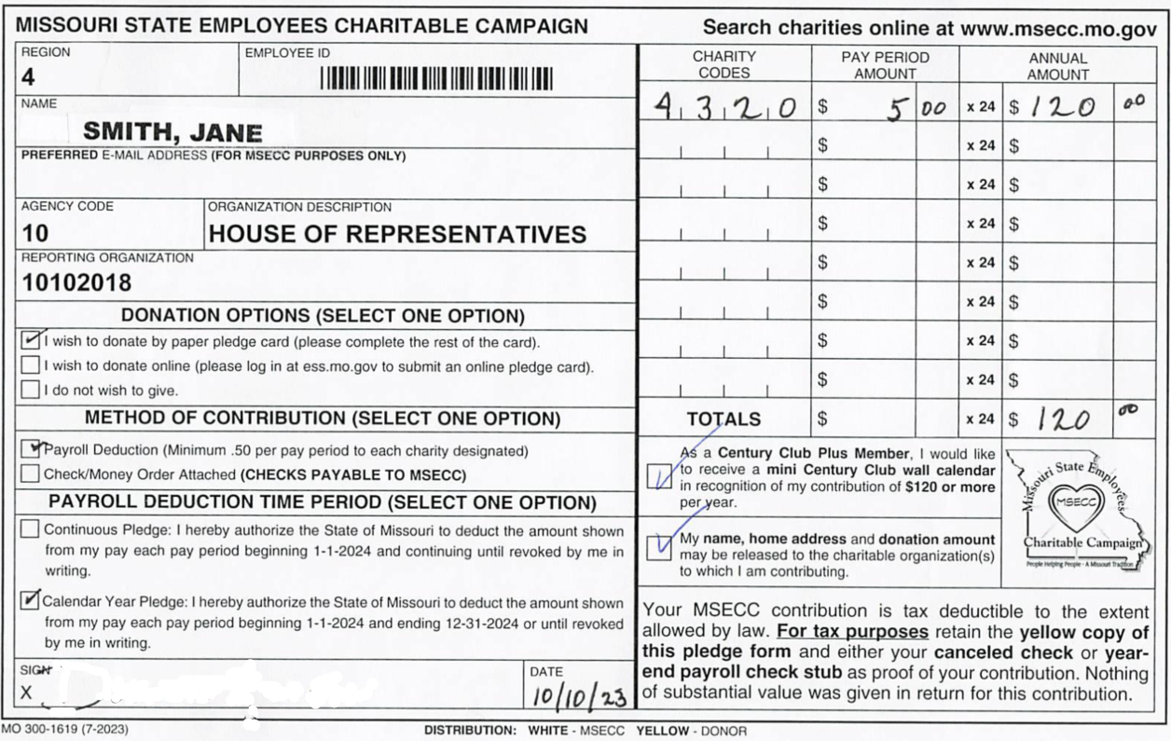
Prefilled Pledge Card
  Should only be used for the employee that is listed on the card.
  Can be used for Payroll Deduction
  Can be used for Check Donation
  Must be signed
Jane Smith

Slide 21
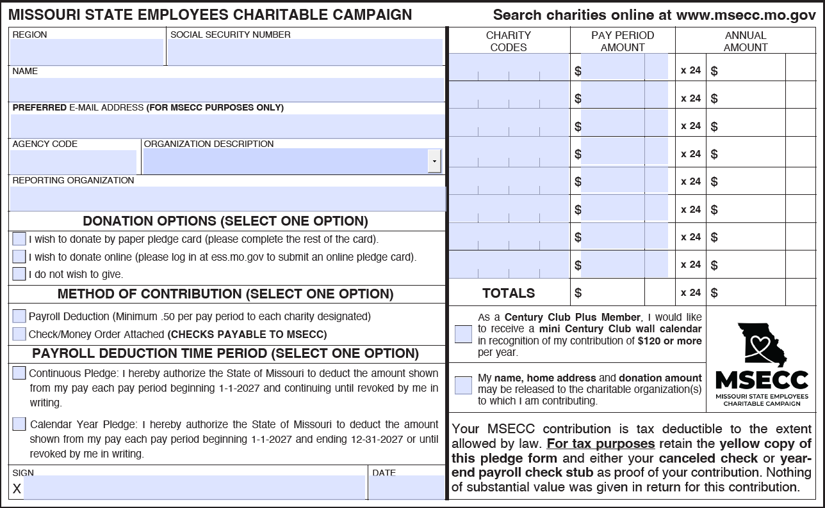
Blank Pledge Card
  Use for Payroll Deductions
  Use for Check Donations
  Use for Fundraisers

Slide 22
White copy – MSECC / Yellow copy – EMPLOYEE COPY
Check box for Method of Contribution
Check box for Payroll Deduction Time Period (calendar year or continuous)
Payroll deduction MUST be signed and dated
Pledges of $120 or more check the box to receive MSECC Wall Calendar
Check box if donor wants their name, home address and donation amount released to charity
Blank pledge cards must complete Name and SSN
Paper Pledge Card Notes

Slide 23
Coordinators - please verify the accuracy of paper pledge cards
  Ensure that the pay period pledge matches the annual totals; the annual amount MUST be evenly divisible by the pay periods
  Please send pledge cards with checks immediately, keep checks attached to pledge cards
  No cash, please! Coordinators should obtain a money order or write a check instead of cash
Paper Pledge Card Notes

Slide 24
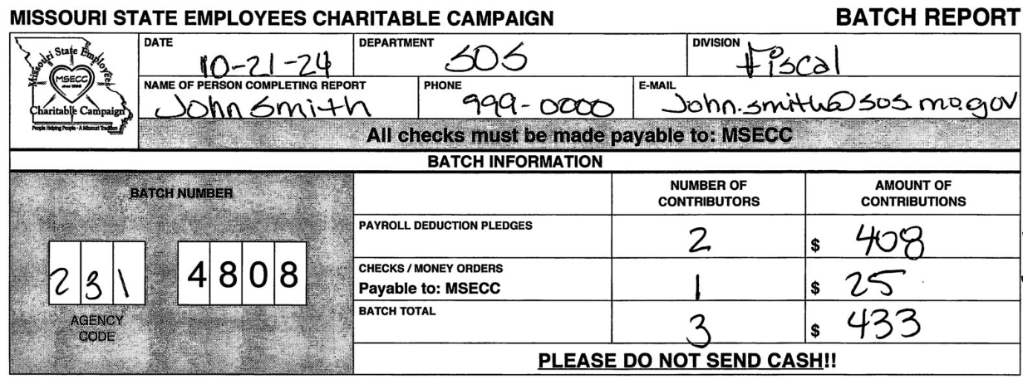
Batch Reports & Envelopes
Batch – 50 or fewer pledge cards
Verify accuracy on each batch report
Multiple batches may be included in a batch envelope
Send all batches through your department coordinator (unless otherwise instructed)

Slide 25
Notes for Coordinators
You may contact any MSECC charity to participate in your agency kick-off events and fundraisers
Charities MAY NOT directly solicit state employees or coordinators
Charities MAY NOT sell items or collect donations at your events
All funds collected at events must be submitted to MSECC
Donations are distributed to charity organizations quarterly: April 2027, July 2027, October 2027, and January 2028
Remember the minimum payroll deduction is $0.50 per pay period to each charity

Slide 26

MSECC Badge for Email Signature
Available on the MSECC Website Home Page with instructions
msecc.mo.gov
Badge is optional, make sure your agency allows the use of MSECC signature badge

Slide 27
Policy for Incentive Items
2009 Legal Determination
Campaign coordinators should include all employees in incentive drawings whether the employee contributes to pledge drive

Slide 28

Deadline for Pledge Drive
October 30, 2026
Please have all pledge cards submitted to MSECC Office by Friday, October 30, 2026.

Slide 29

Thank you!
Please join us for lunch and be sure to visit with the charitable organizations on the 1st and 2nd floors

