Slide 1
Coordinator Training
August 27, 2025
Notes:
Click record on training

Slide 2
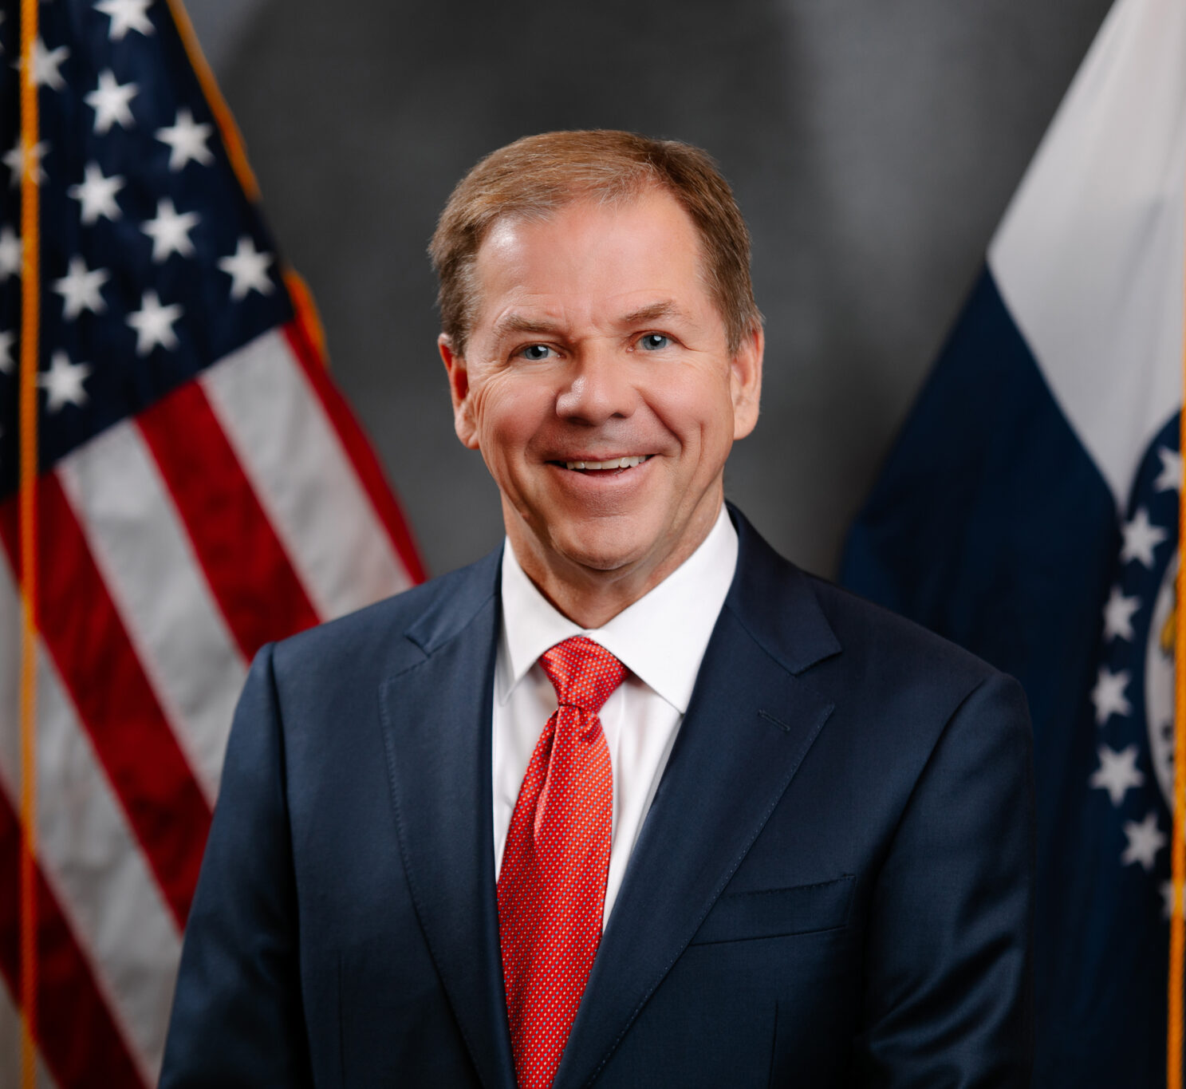
Chairman of the 2026 Missouri State Employees Charitable Campaign
Lieutenant Governor David Wasinger

Slide 3
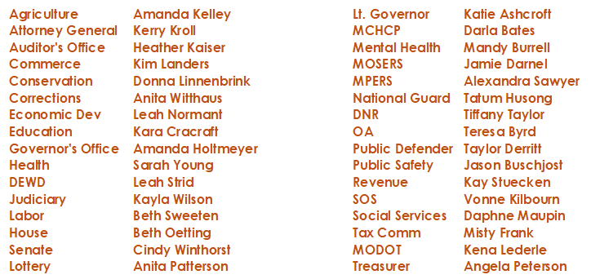
Department Coordinators

Slide 4
What is MSECC?
MSECC is a unified fundraising program for state employees administered by the Office of Administration
Comprised of charitable organizations that apply to the MSECC for possible inclusion
Payroll deduction offers employees a convenient way to contribute (tax deductible)
Participating charities provide vital services and meet many needs in our local communities and state

Slide 5
What is Your Role?
Provide leadership & serve as the main campaign resource for your coworkers
Distribute pledge cards to employees or direct them to the online system
Encourage participation – without pressure
Be positive and enthusiastic about the campaign
Encourage agency management’s involvement

Slide 6
What is Your Role?
Plan events: https://msecc.mo.gov/coordinators/
The campaign period should be no more than two weeks
Distribute pledge cards no later than October 15
Collect completed pledge cards by October 31
Send completed pledge cards to your department coordinator OR directly to the MSECC office via inter-agency mail

Slide 7
“Service to others is the rent you pay for your room here on earth.”
~Mohammed Ali

Slide 8
Fun Facts:
If every state team member donated $1 per pay period, more than $1.2 million dollars would be raised for charity.
9.64% participated last year
4,941 team members donated last year
$756,731 raised last year

Slide 9
Quick Charity Reference Guide
The Quick Charity Reference Guide was not printed, a PDF is available to print on the website
Charities are listed alphabetically by regions
Charity descriptions listed on www.msecc.mo.gov under the “Charities” link
479 charities are enrolled in the 2026 campaign
Applications decreased by 133, some popular charities may not be participating

Slide 10
New Charities 2026
Boone Center Incorporated
Capital City Diaper Bank, Inc
Carthage Area United Way
Child Advocacy Center, Inc
Christina Bohn Foundation
Dream Factory Inc
Dream Factory Lake of Ozarks
Dream Factory of Northwest MO
Dream Factory of St. Louis
First Responder Provider Network
Global Impact
Immigrant Home English Learning Programs
Life Network Central Mo DBA My Life Clinic
Mid Missouri Arts Alliance
Mission Monipaw
Missouri Law Enforcement Assistance Team
The Covering House
The NRA Foundation
Wonderland Camp Foundation

Slide 11
Campaign Website
https://msecc.mo.gov
Message from Lieutenant Governor David Wasinger
2025 Final Fact Sheet
2026 Campaign Poster
2026 Email Signature Badge
Search for any Charities
Charity Quick Reference Guide
List of New Charities
2025 Total Donations
Coordinators Link
Retirees Link
FAQ
Campaign Tracker
Credit Card Portal

Slide 12
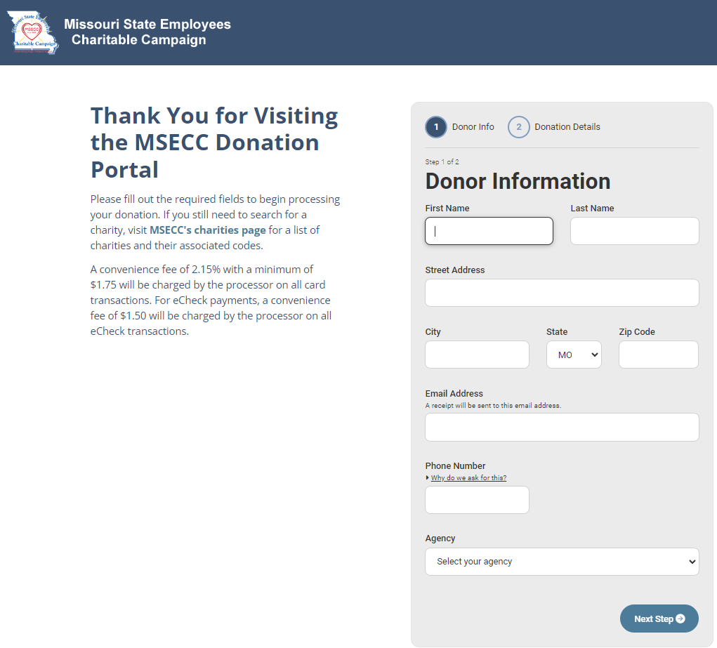
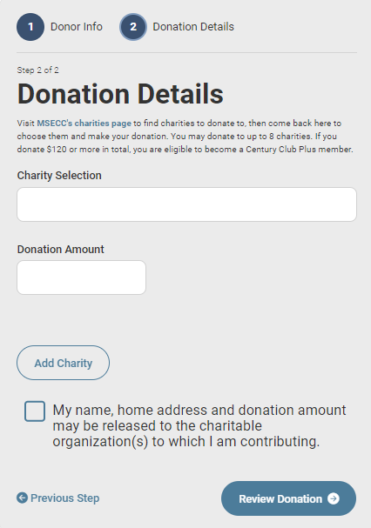
Credit Card Donations

Slide 13
Online Pledge Card
Available in the Employee Self-Service Portal (ESS)
https://ess.mo.gov/
Only for payroll deductions
Donations by check or money order must by submitted with paper pledge card
Instructions for both ONLINE donors and PAPER PLEDGES are available on the Coordinator tab of the MSECC webpage
https://msecc.mo.gov

Slide 14
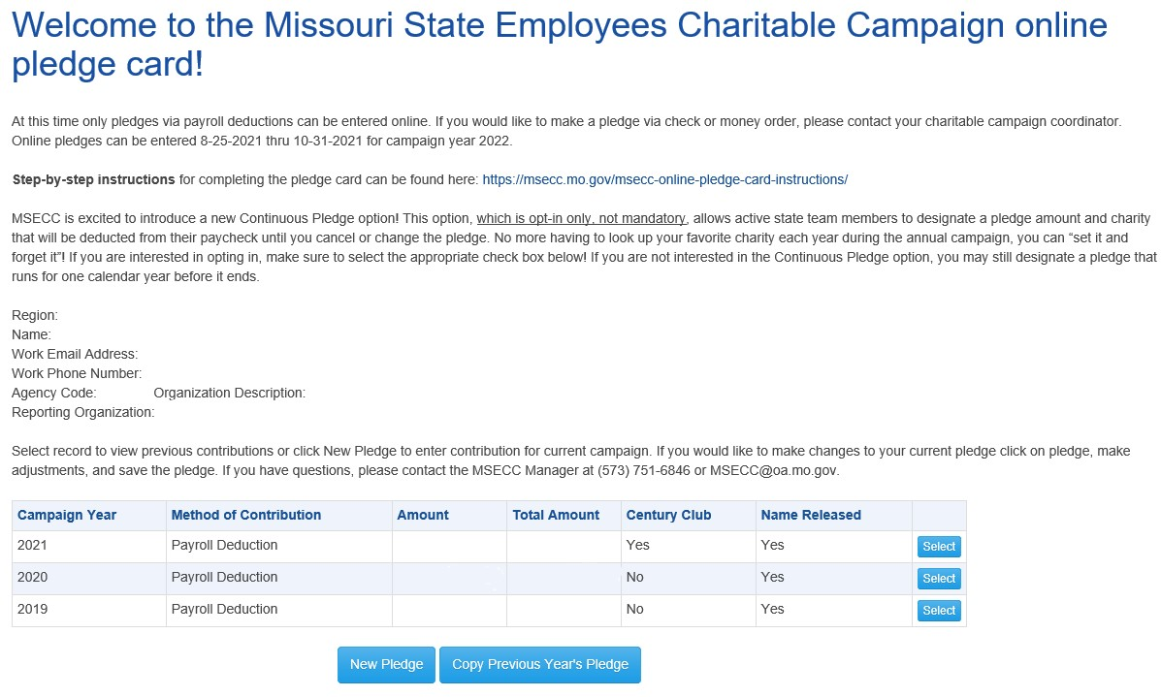
Online Pledge Card
https://ess.mo.gov/Member/MseccPledgeCard

Slide 15
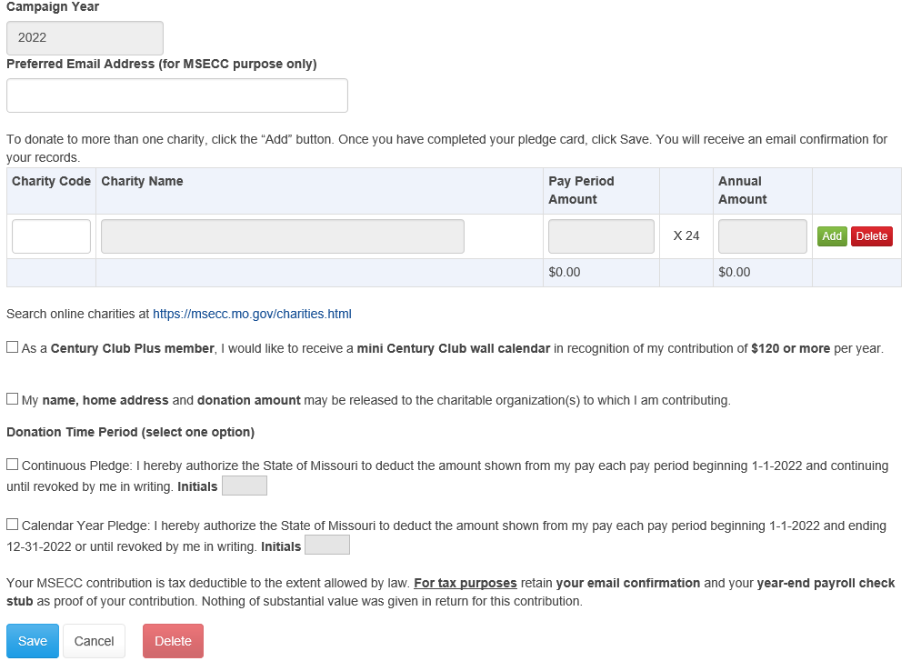
Online Pledge Card
https://ess.mo.gov/Member/MseccPledgeCard

Slide 16
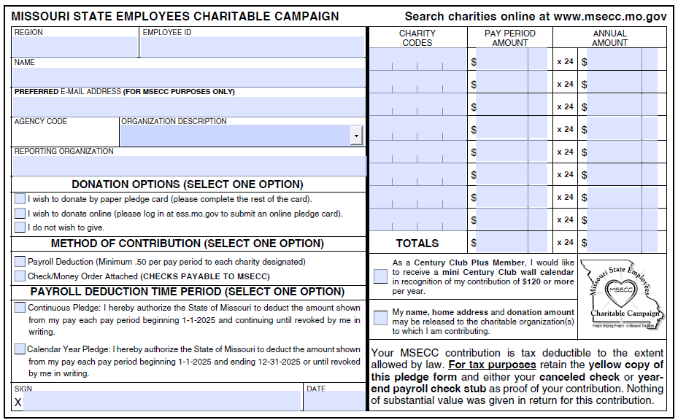
Paper Pledge Card

Slide 17
Paper Pledge Card Info.
White copy – MSECC / Yellow copy – EMPLOYEE COPY
A box must be checked for method of payment, and payroll deduction time period (calendar year or continuous)
Payroll deduction - MUST be signed and dated
Century Club – if pledge $120 or greater and employee checks box, they will be sent MSECC wall calendar
Name/home address/donation amount – information released to charity(s) they pledged to
Blank pledge cards must have name, last 4 digits of SSN
Do not need to submit “I Do Not Wish to Give” or pledge cards where they indicate they will donate online; please recycle

Slide 18
Paper Pledge Card Notes
Verify the accuracy
Ensure pay period amount = the annual amount
The annual amount MUST be equally divisible by the pay periods
No staples - please use paper clips to attach checks and money orders
Keep checks attached to pledge cards
Please send pledge cards with checks ASAP!
No cash please! Coordinators - write check or obtain money order in place of cash
An individual check is not needed for each pledge card

Slide 19
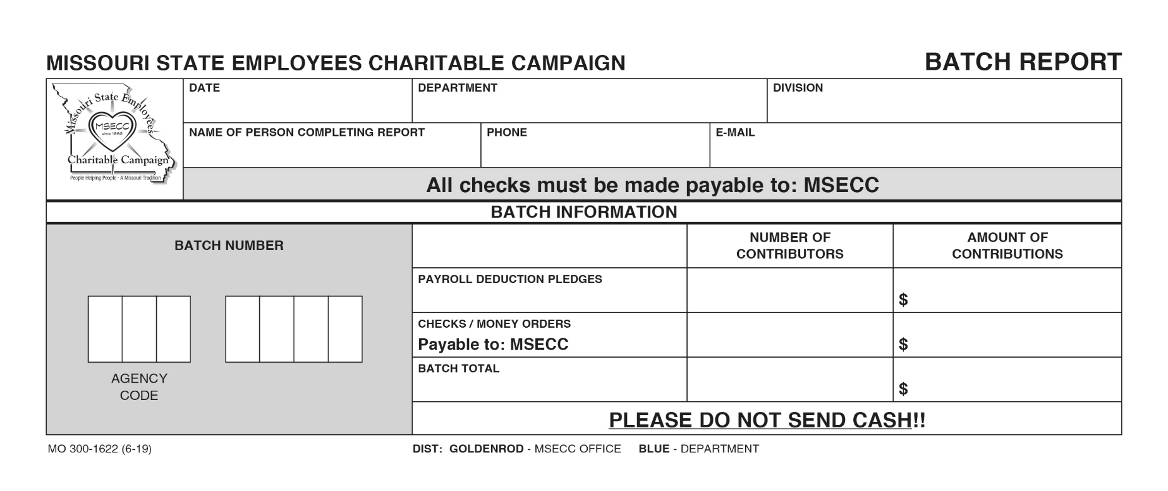
Pledge Cards & Batch Reports
Prepare batch reports
Ensure checks are payable to MSECC
No cash

Slide 20
Batch Reports/Envelopes
Batch – 50 or fewer pledge cards
Verify accuracy on each batch report
Include adding machine tape for each batch report
Multiple batches may be included in a batch envelope
Send all batches through your department coordinator (unless otherwise instructed)

Slide 21
Optional Email Badge
Available on the MSECC website Home Page (with instructions)
Can be placed in email signature (if agency standards allow)

Slide 22
Reminders…
You may contact any MSECC charity to participate in your agency kick-off events
Charities should not directly solicit state employees or coordinators
Any funds collected at your events should be sent to MSECC with a completed pledge card
Money will be disbursed to charity quarterly from our banking vendor, Central Bank
Minimum payroll deduction is $0.50 per pay period to each charity designated

Slide 23
Incentive Policy
2009 Legal Determination
Campaign coordinators should include all returned pledge cards, whether the employee contributes or not, in any drawings they hold.

Slide 24
Deadline---October 31, 2025
Please have all pledge cards submitted to MSECC office by
Friday, October 31, 2025

Slide 25
Thank you
for Building a Brighter Future for all Missourians

